Slide 1

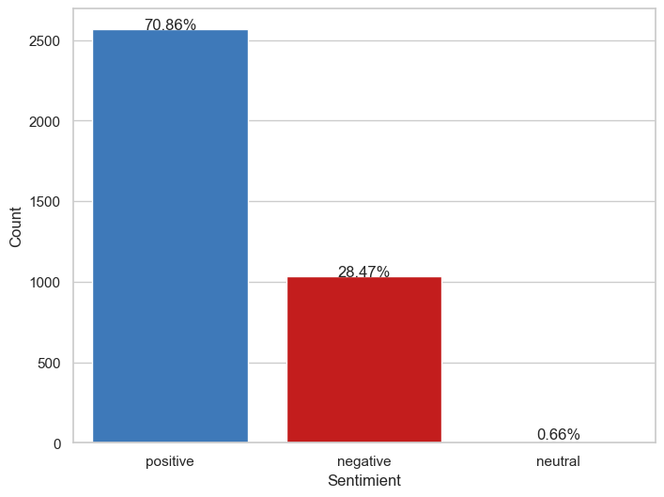
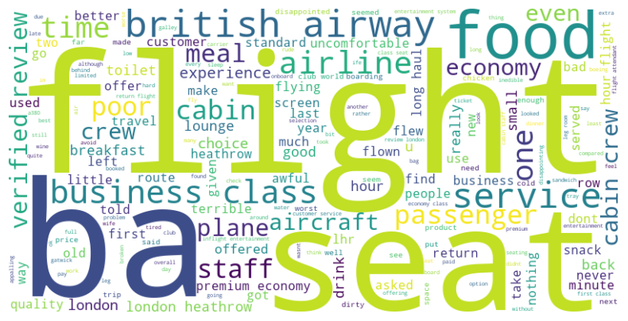
Customer experience review | Sentiment Analysis
The distribution chart of the sentiment analysis shows that there are 71% positive sentiment for the customer experience and 28% negative sentiment.
On the other hand the most common words in a set of negative reviews. The largest words in the cloud are: flight, seat, food, class business, service, cabin, in addition to the company name of course.
These words suggest that the most common complaints about the service are related to flight, seat allocation, and the food. Customers business class also seem to be unhappy
In conclusion, we must work to improve these services to provide better quality customer experience.
Distribution of Sentiment in Reviews
By Diego Sanmiguel
https://www.linkedin.com/in/diegosanmiguelvargas/
https://github.com/dasanmiguelv/supervised-machine-learning/tree/main/behaviour-buying

